Slide 1

PROBLEM UNDERSTANDING & OBJECTIVE
Problem Understanding
  Users need quick, accurate answers from their own documents (PDFs, DOCX, TXT)
  Traditional keyword search fails to:
    Understand intent
    Provide summarized or contextual answers
  Need an AI system that is:
    Context-aware
    Grounded in uploaded documents
    Transparent via confidence scoring
Objective
  Build a Mini Retrieval-Augmented Generation (RAG) Assistant that:
    Allows users to upload documents
    Answers questions strictly from document context
    Shows confidence scores based on retrieval relevance
    Runs as a lightweight, interactive Streamlit POC

Slide 2
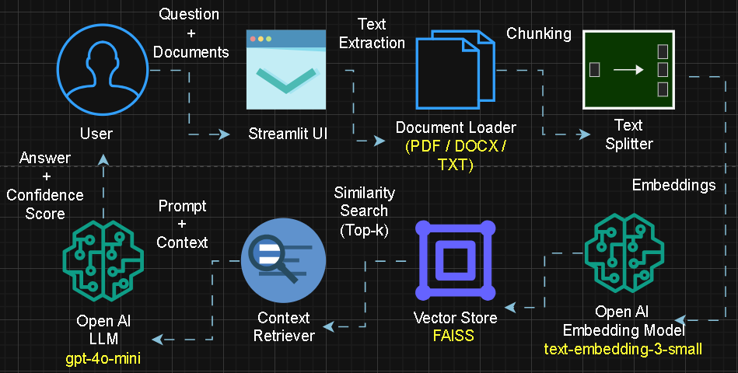
SOLUTION ARCHITECTURE & DESIGN FLOW

Slide 3
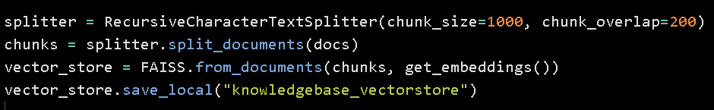
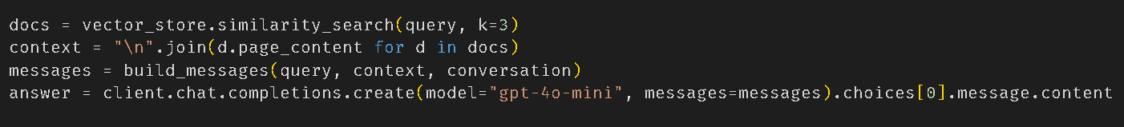
IMPLEMENTATION HIGHLIGHTS
Key Technical Decisions
  Streamlit for rapid UI prototyping
  FAISS for fast local vector search
  OpenAI Embeddings for semantic accuracy
  No hallucination
UI Features
  Document upload
  Query input box
  Answer section
  Confidence score display
AI Logic Highlights
  Chunking using RecursiveCharacterTextSplitter
  Top-k similarity retrieval
  Confidence score

Slide 4
CHALLENGES & LEARNINGS
Challenges
  Library & Documentation Changes
  Long document processing time
  Handling irrelevant retrievals
  Confidence Score
Trade-offs
  FAISS chosen over Chroma for simplicity
  Smaller embedding model for speed vs accuracy
  Limited chunk size to balance context quality
Key Learnings
  Retrieval quality directly impacts answer quality
  Confidence scoring is not trivial and must be logic-driven
  Chunking strategy is critical for RAG performance
  RAG systems need guardrails to avoid hallucinations

Slide 5
DEMO SUMMARY & NEXT STEPS
Final Solution
  Multi-document upload
  Context-grounded Q&A
  Confidence scoring
  Interactive Streamlit UI
Demo / Repository
  Demo: GoogleDrive-Link
  Code: Git-Repo
  Tech Stack: Python, Streamlit, FAISS, OpenAI, LangChain
Enhancements
  Switch to hybrid search (keyword + semantic)
  Better confidence calibration
  Source citation per answer
  Caching embeddings for performance
  Role-based access & authentication
  Deployment on cloud (AWS / GCP)
  Adding Voice Interaction (STT & TTS)

